Slide 1

G2M Case Study
Virtual Internship
Nada Alzahrani
9-March-2021

Slide 2
Objective : Provide actionable insights to help XYZ firm in identifying the right company for making investment.
Dataset:
Cab_Data
Customer_ID
Transaction_ID
City
G2M Cab DataSets
XYZ is a private firm in US. Due to remarkable growth in the Cab Industry in last few years and multiple key players in the market, it is planning for an investment in Cab industry and as per their Go-to-Market(G2M) strategy they want to understand the market before taking final decision.

Slide 3
Analysis:
Merge dataset
Convert date column
Create new column
EDA
Hypothesis
Data Exploration
17 Features
Timeframe of the data: 31/01/2016 to 31/12/2018
Total data points : 359392
Format : csv

Slide 4
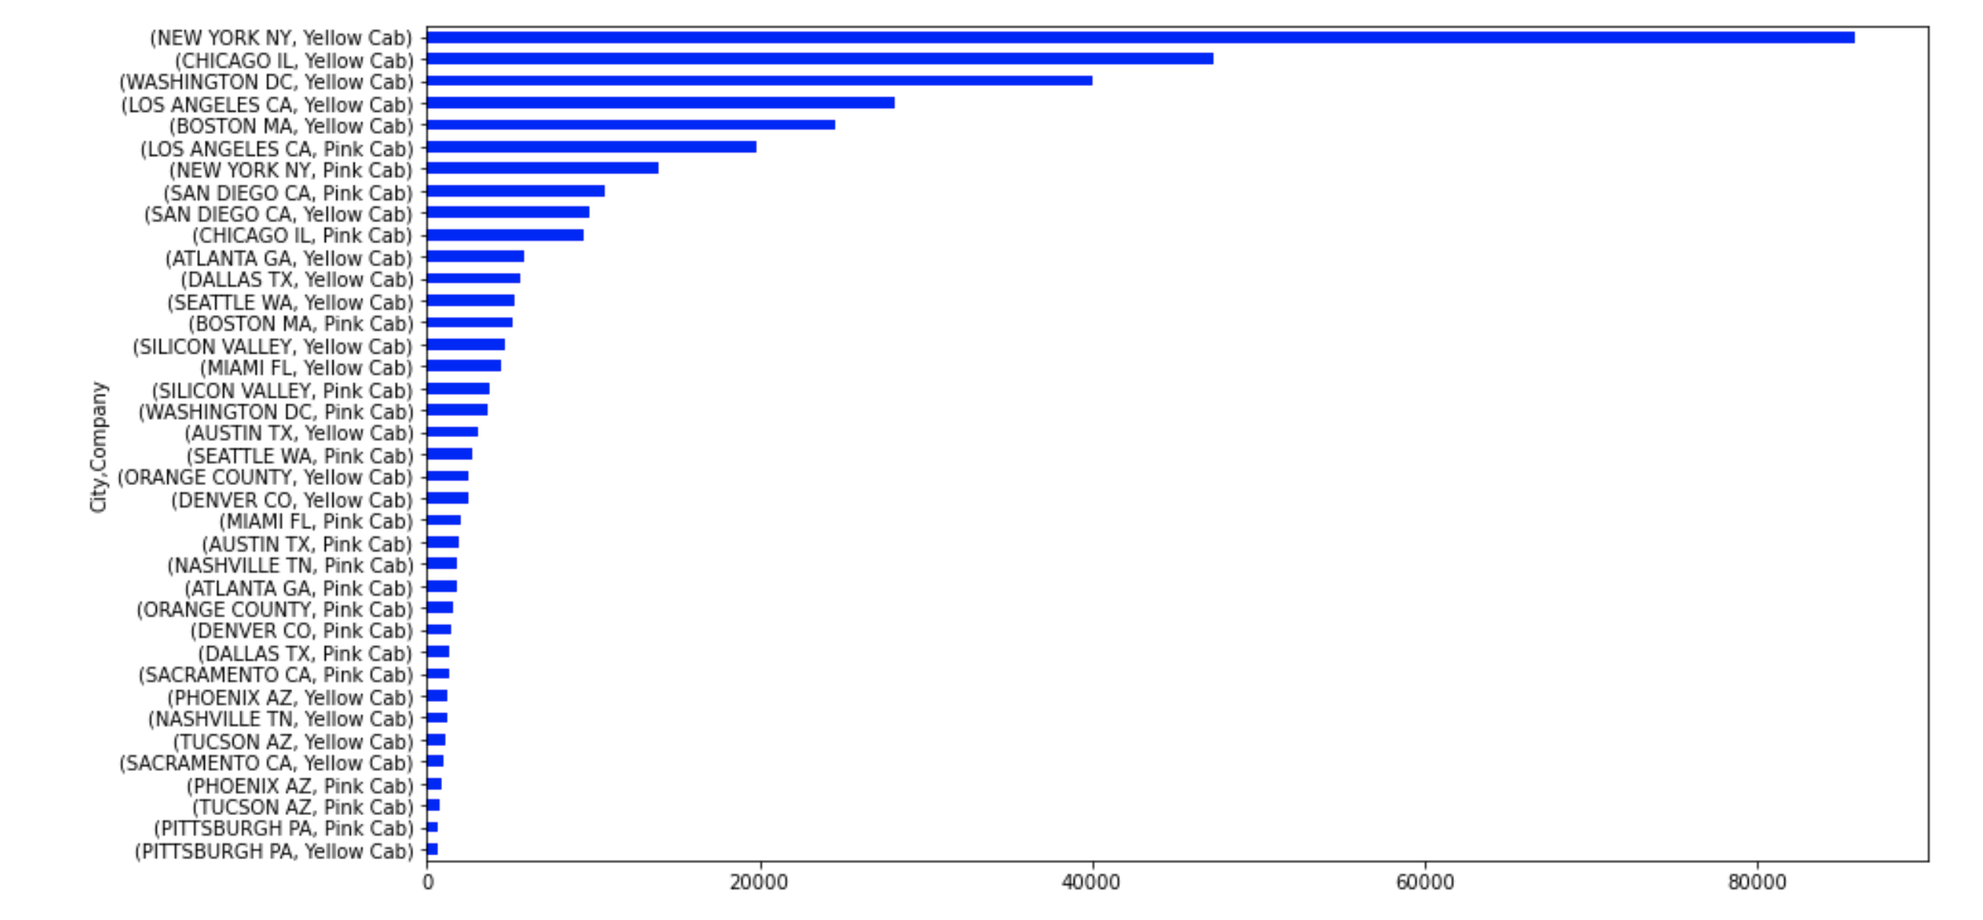
Yellow Cabs are the most cabs
Cab Analysis

Slide 5
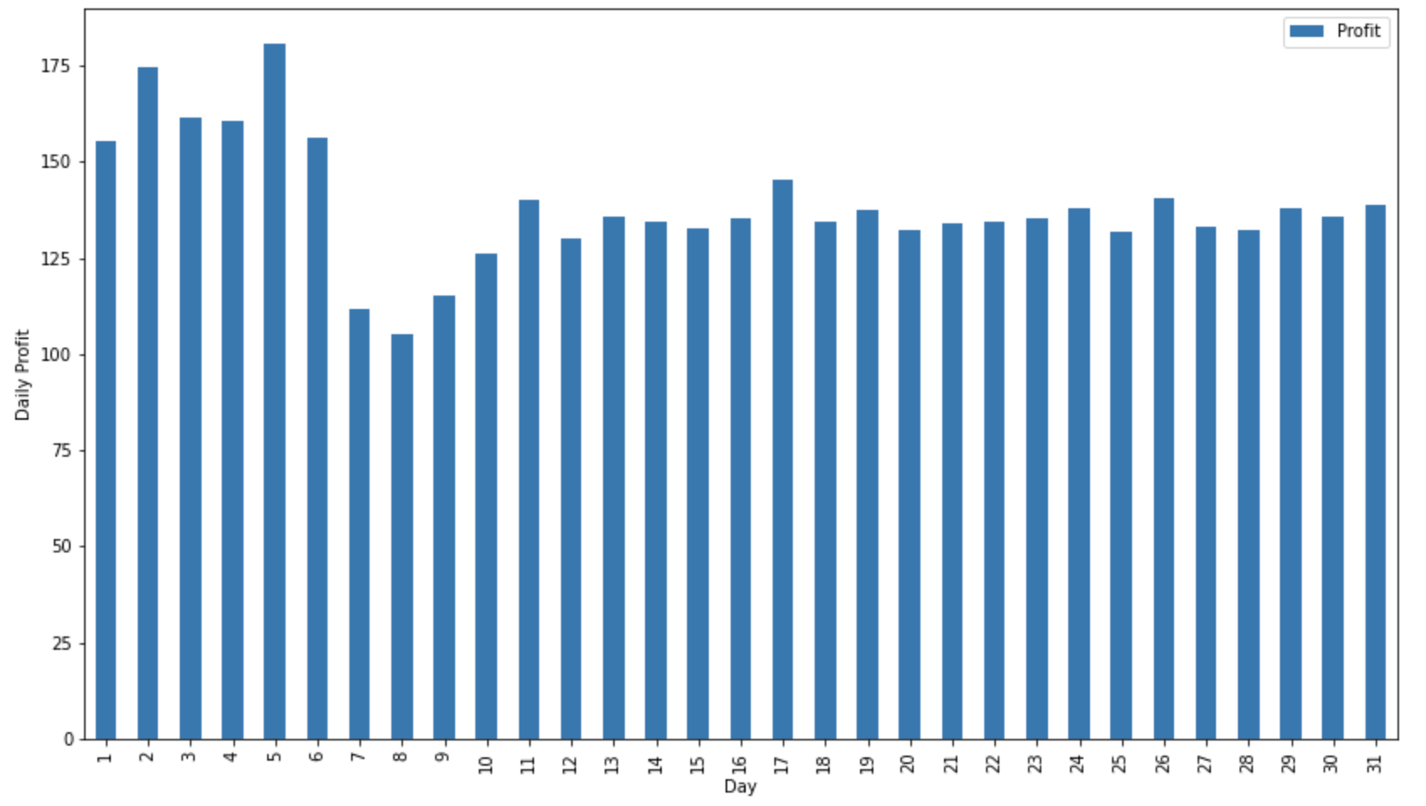
Daily profit Analysis
There is some seasonality over a month. Profit is higher in the beginning of a month.

Slide 6
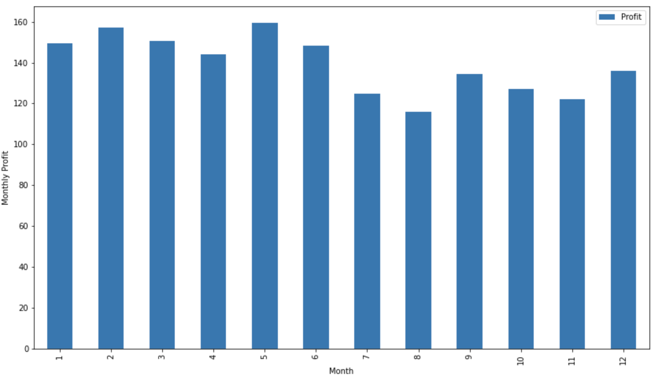
Monthly Profit Analysis
During the months of February and May people tend to travel larger distance and hence the profit charged is more.

Slide 7
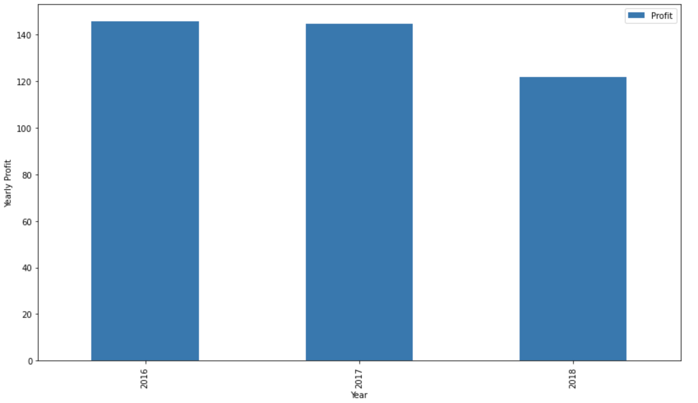
Yearly Profit Analysis
In 2018 price charged was comparatively less than 2017 and 2016.

Slide 8
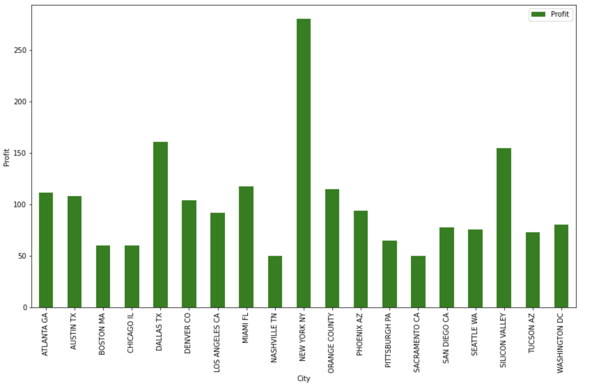
Top cities with highest profit
NEW YORK NY, DALLAS TX, SILICON VALLEY and MIAMI FL are the top cities with the highest profit

Slide 9
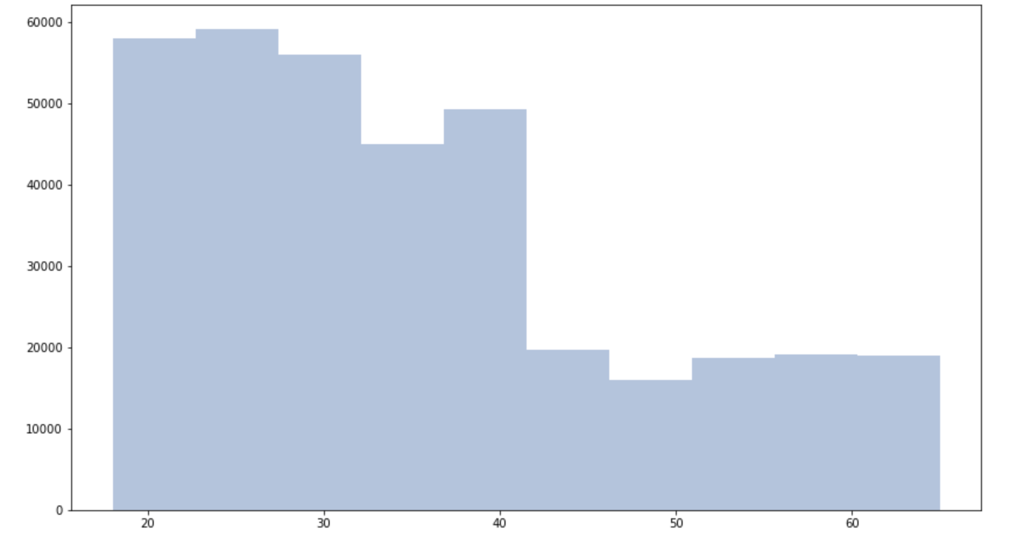
Most of the users are between 20 to 40 years
User's age

Slide 10
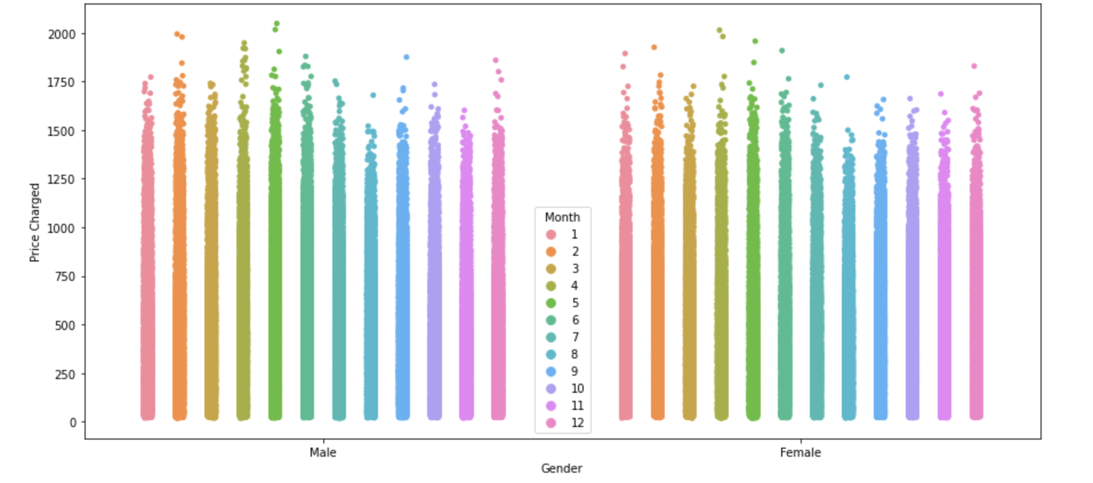
There is no discount for Female customers as the price distribution is very similar for both gender considered over yearly.
Price difference based on gender

Slide 11
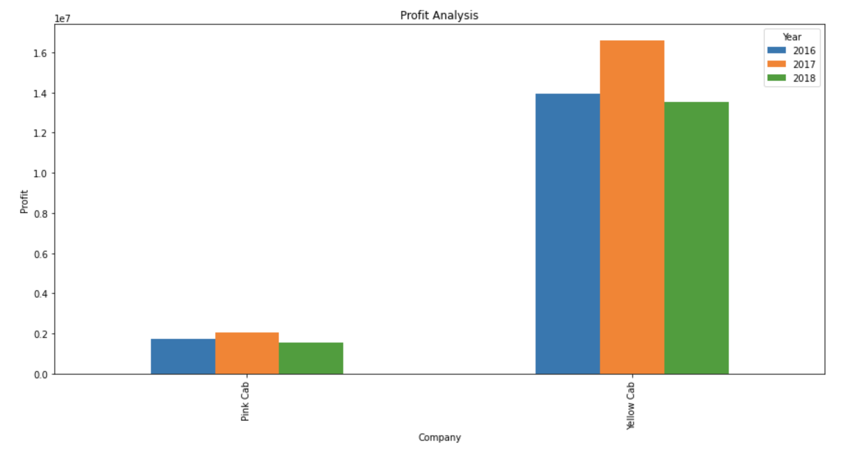
Preferred Cab Company
Yellow Cabs are used more than Pink Cabs.
More than 76% cabs.

Slide 12
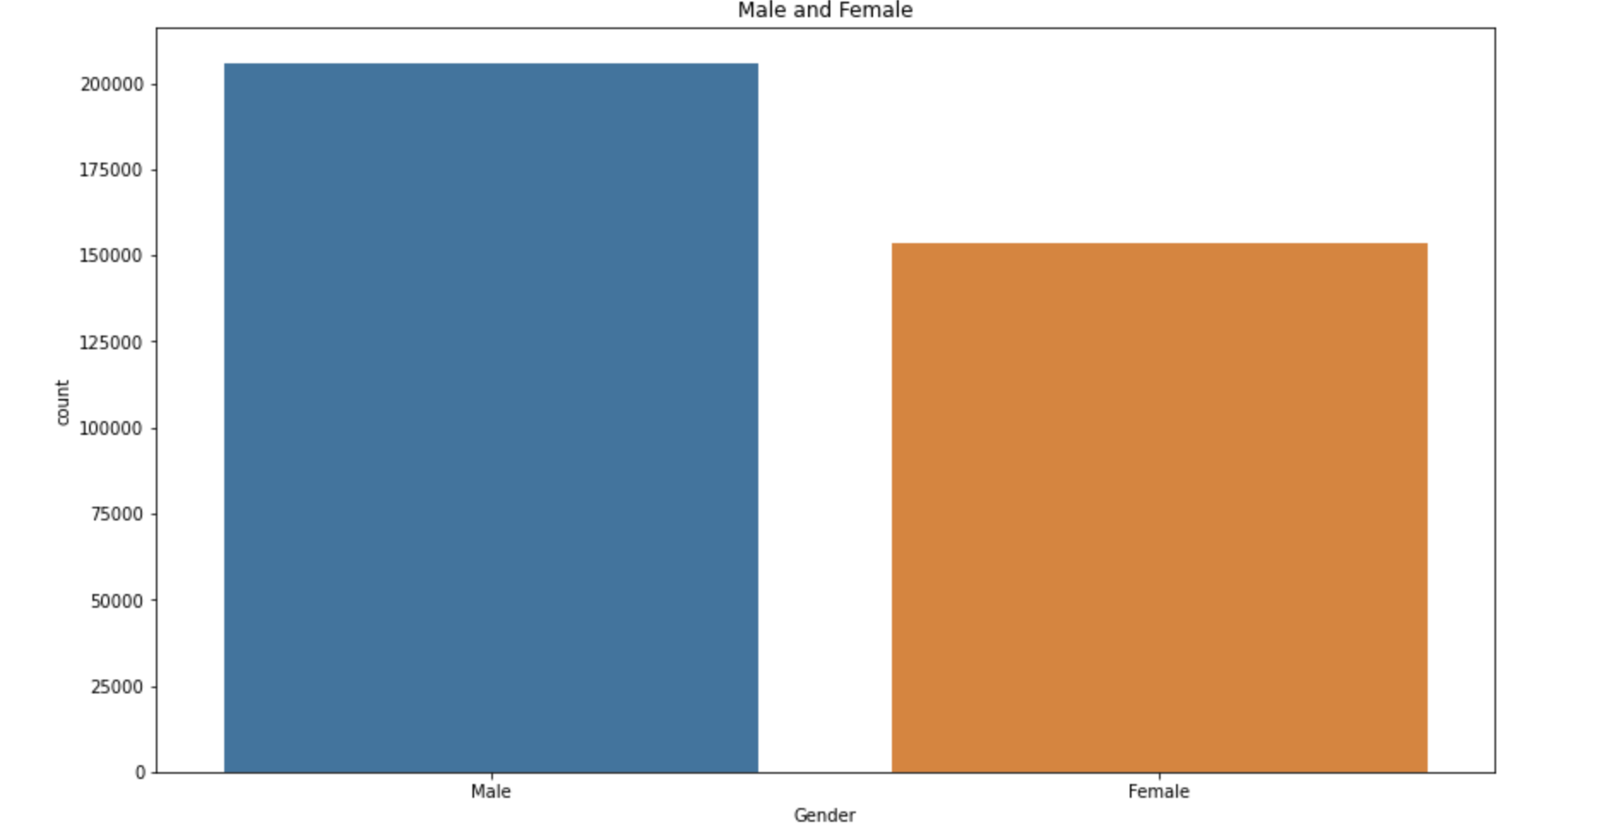
Male customers more than female
Gender Analysis

Slide 13
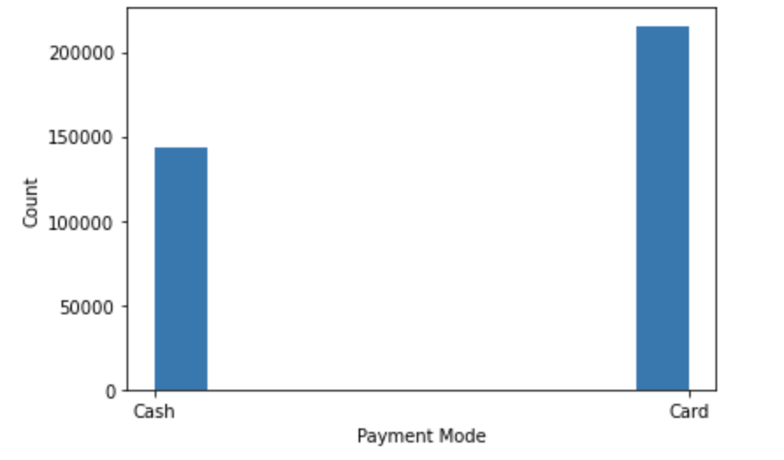
Payment Analysis
Card is preferred
over cash payment

Slide 14
Hypothesis
KM Travelled
p-values 0.007448586391893619, we are rejecting null hypothesis
Price Charged
p-values 0.7531470891273166, we are accepting null hypothesis
Age
p-values 8.61181075357829e-08, we are rejecting null hypothesis
Income (USD/Month)
p-values 0.13754435916764565, we are accepting null hypothesis
Profit
p-values 0.31890486823165864, we are accepting null hypothesis

Slide 15
Recommendations
We have evaluated both the cab companies on following points and found Yellow cab better than Pink cab:
Customer Reach : Yellow cab has higher customer reach in most of the cities while Pink cab has higher customer reach in very few cities.
Users age : Most of the users are between 20 to 40 years
Mode of payment : Card payment is preferred over cash payment generally so XYZ private firm could offer some discounts on card payment which would further increase the no. of customer which in turn would increase the profit.
Profit : It was observed that the cost of travel was uniform across the cities, but the price charged was the highest in NEW YORK NY, DALLAS TX, SILICON VALLEY and MIAMI FL
Gender : It was observed that male customers more than the female customers.
After analyzing all the points, Yellow Cab Company is highly recommended for investment.

Slide 16
THANK YOU

